Slide 1

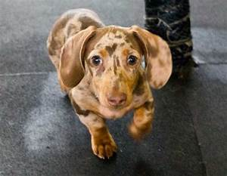
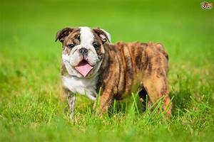
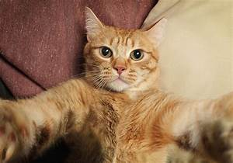
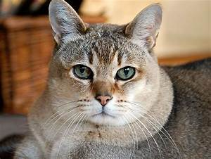
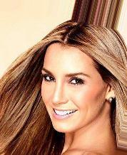
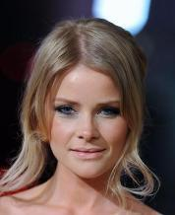
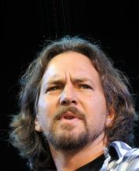
Image Generation with cGANs
CHRISTOPH MEIER VANESSA GUBLER

Slide 2
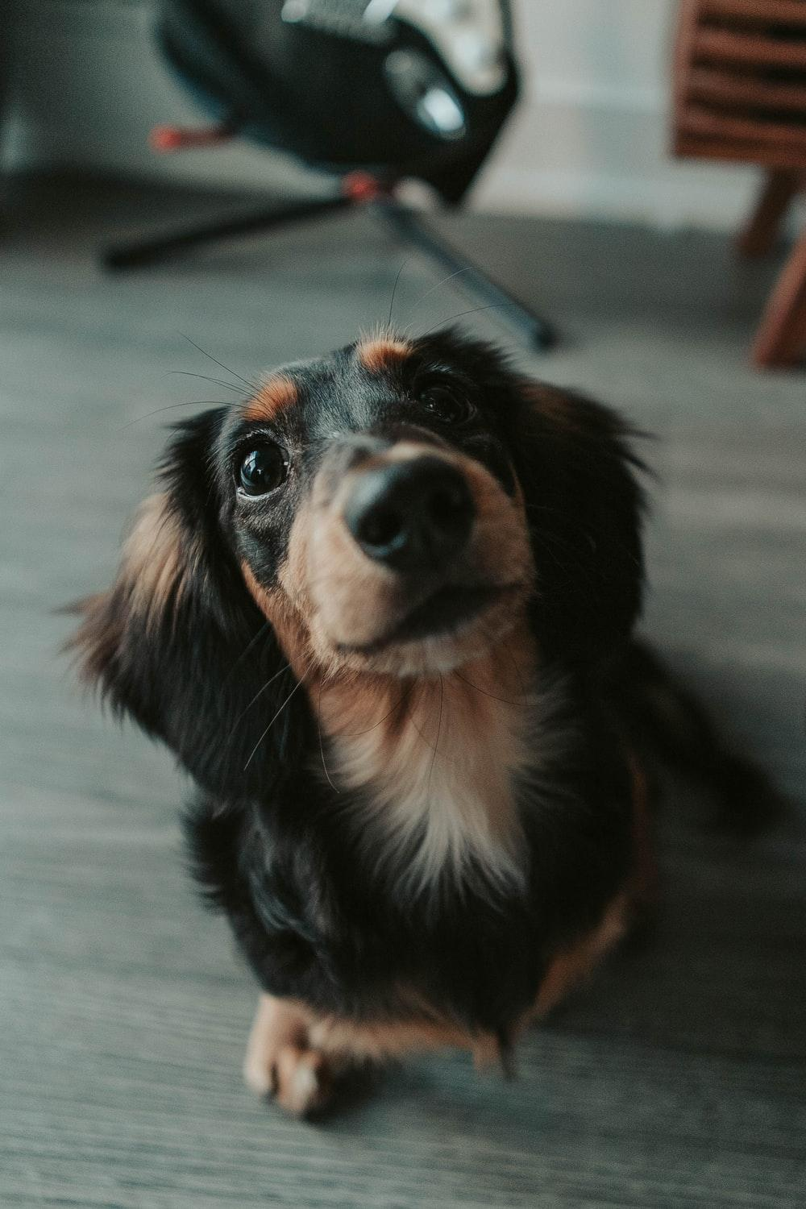
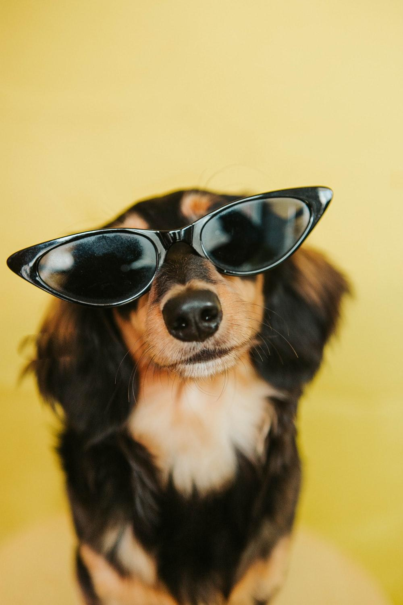
What the project is about
Goal
Create images of humans, dogs and cats
Put them glasses on
Approach
Create a conditional GAN with four classes
Humans, dogs, cats, glasses
Glass labels are taken from the human images' dataset

Slide 3
Data
Human data
CelebA dataset, provided by employees of the Chinese University of Hong Kong
202’599 images, of which 13’193 are labelled with «eyeglasses»
Dog and cat data
Animal-10 dataset, provided by Alessio Corrado
4‘863 dog images and 1‘668 cat images

Slide 4
Hyperparameters
Batch size
Number of channels
Number of classes
Image size
Latent space
Epochs
Number of input images
Model structure

Slide 5
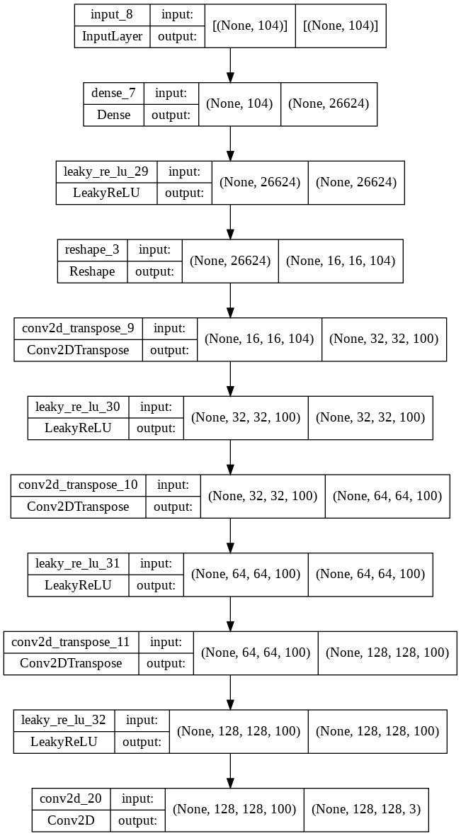
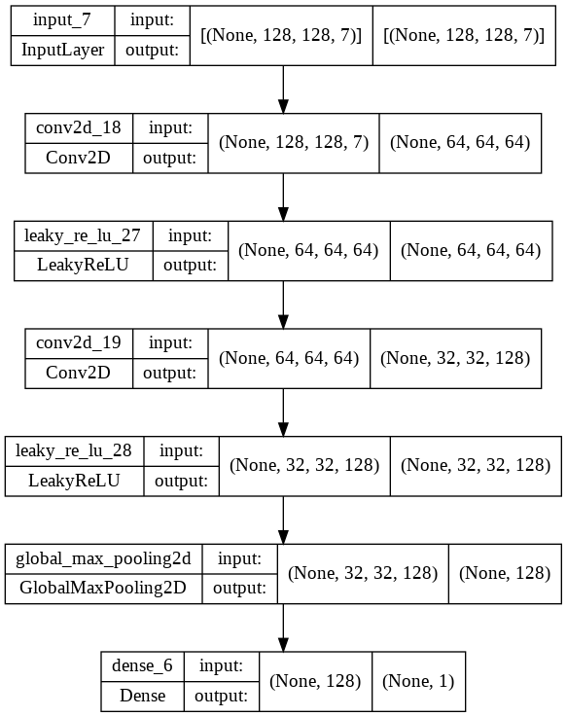
Run 1
Conditional GAN on MNIST dataset provided by Keras as a basis
Generator
Discriminator

Slide 6
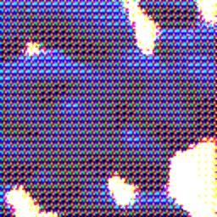
Run 1
Batch size: 64
Number of channels: 3 (RGB-scaling of images)
Number of classes: 4 (human, dog, cat, eyeglasses)
Image size: 128 * 128 px
Latent space: 128 dimensions
Epochs: 200
Number of input images:
Human images: 10‘000
Dog images: 4‘863
Cat images: 1‘668

Slide 7
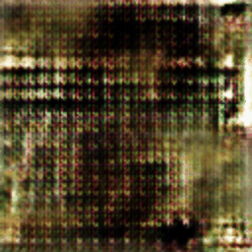
Run 2
Batch size: 64
Number of channels: 3 (RGB-scaling of images)
Number of classes: 4 (human, dog, cat, eyeglasses)
Image size: 128 * 128 px
Latent space: 128 dimensions → 100
Epochs: 200 → 100
Number of input images:
Human images: 10‘000 → 4’000
Dog images: 4‘863 → 4’000
Cat images: 1‘668

Slide 8
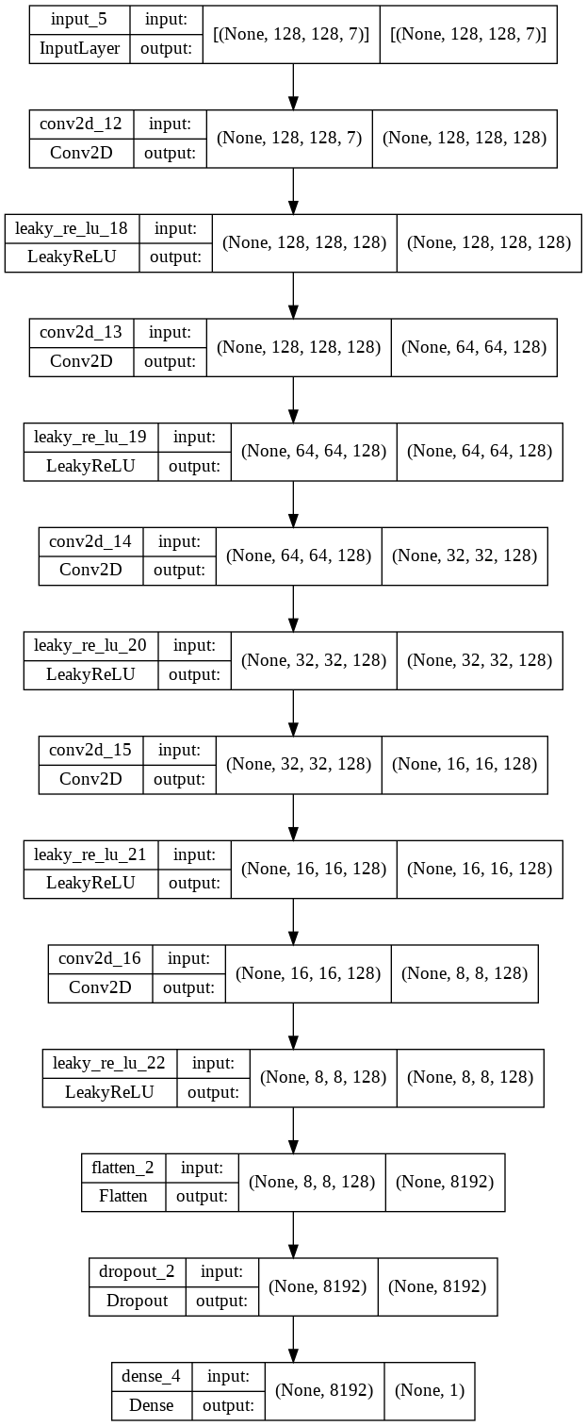
Run 3
Initial model structure not suitable for the datasets
Research on and implementation of applicable structure
Changes on the discriminator

Slide 9

Run 3
Batch size: 64
Number of channels: 3 (RGB-scaling of images)
Number of classes: 4 (human, dog, cat, eyeglasses)
Image size: 128 * 128 px
Latent space: 100 dimensions → 128
Epochs: 100
Number of input images:
Human images: 4‘000 → 2’000
Dog images: 4‘000 → 2’000
Cat images: 1‘668

Slide 10
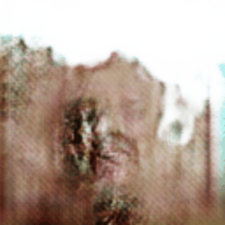
Run 4
Batch size: 64 → 32
Number of channels: 3 (RGB-scaling of images)
Number of classes: 4 (human, dog, cat, eyeglasses)
Image size: 128 * 128 px
Latent space: 128 dimensions → 100
Epochs: 100 → 50
Number of input images:
Human images: 2‘000 → 23’600
Dog images: 2‘000 → 4’800
Cat images: 1‘668 → 1’600

Slide 11
Run 5
Augmentation of data for an equal distribution of the input images
Augmentations of the dog and cat images:
Horizontal flip
Height shift
Width shift
Rotation
Brightness

Slide 12
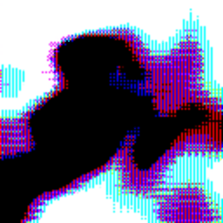
Run 5
Batch size: 32 → 30
Number of channels: 3 (RGB-scaling of images)
Number of classes: 4 (human, dog, cat, eyeglasses)
Image size: 128 * 128 px
Latent space: 100 dimensions
Epochs: 50
Number of input images:
Human images: 23‘600 → 10‘000
Dog images: 4‘800 → 9‘600
Cat images: 1‘600 → 9‘600

Slide 13
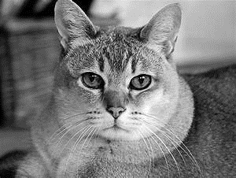
Run 6
No RGB-scaling of the images, only gray-scale
This reduces the number of channels from 3 to 1

Slide 14
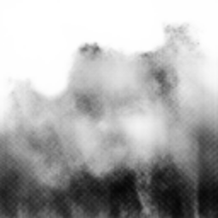
Run 6
Batch size: 30
Number of channels: 3 → 1 (grey-scaling of images)
Number of classes: 4 (human, dog, cat, eyeglasses)
Image size: 128 * 128 px
Latent space: 100 dimensions
Epochs: 50
Number of input images:
Human images: 10‘000 → 20‘000
Dog images: 9‘600 → 19‘200
Cat images: 9‘600 → 19‘200

Slide 15
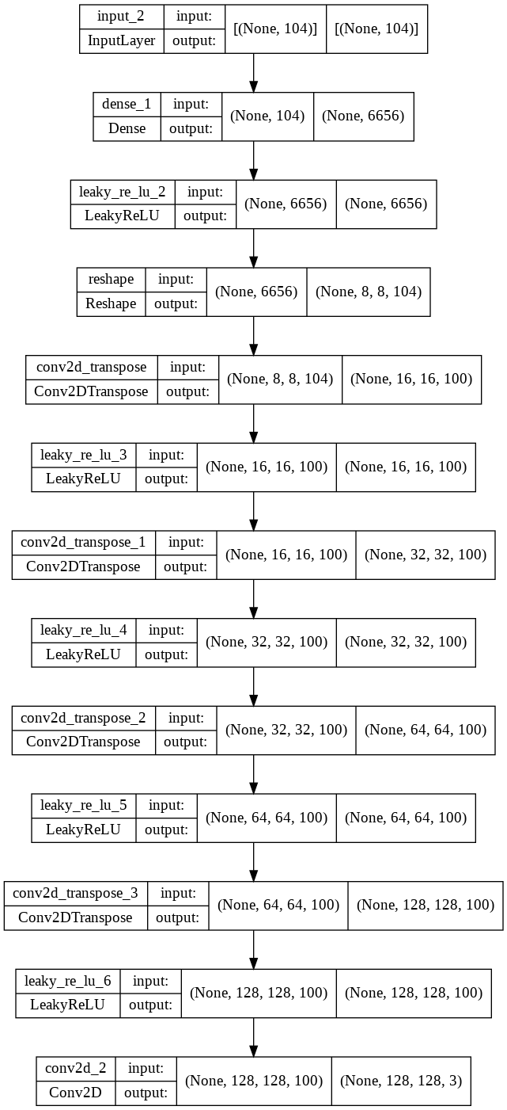
Run 7
Changes in the generator (added complexity)

Slide 16
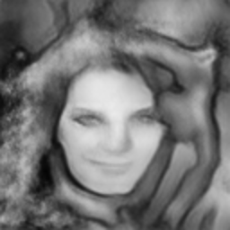
Run 7
Batch size: 30
Number of channels: 1 (grey-scaling of images)
Number of classes: 4 (human, dog, cat, eyeglasses)
Image size: 128 * 128 px
Latent space: 100 dimensions
Epochs: 50 → 40
Number of input images:
Human images: 20‘000
Dog images: 19‘200
Cat images: 19‘200

Slide 17
Run 8
Since eyeglasses are the most important feature to put glasses on a given face, we separate them to assure they are represented with as many images as possible
Therefore, we import the eyeglasses not only in the context of human faces, but also in a separate folder with images of faces with eyeglasses

Slide 18
Run 8
Batch size: 30
Number of channels: 1 (grey-scaling of images)
Number of classes: 4 (human, dog, cat, eyeglasses)
Image size: 128 * 128 px
Latent space: 100 dimensions
Epochs: 50 → 20
Number of input images:
Human images: 20‘000 → 10‘000
Dog images: 19‘200 → 14‘400
Cat images: 19‘200 → 14‘400
Eyeglasses images: 19‘200 → 3’397
Placeholder for result gif

Slide 19
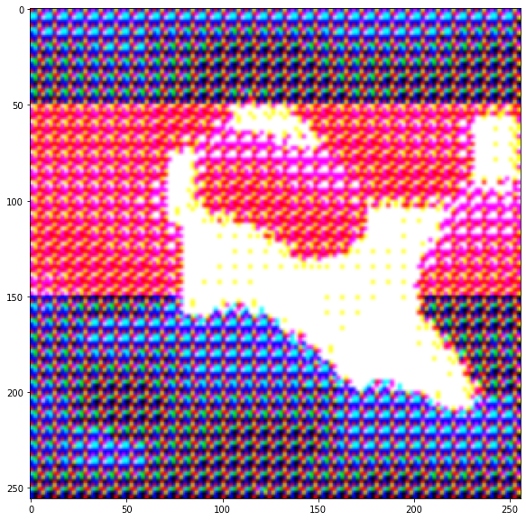
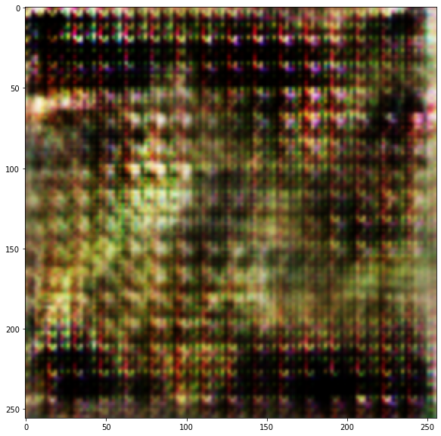
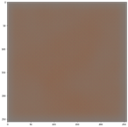
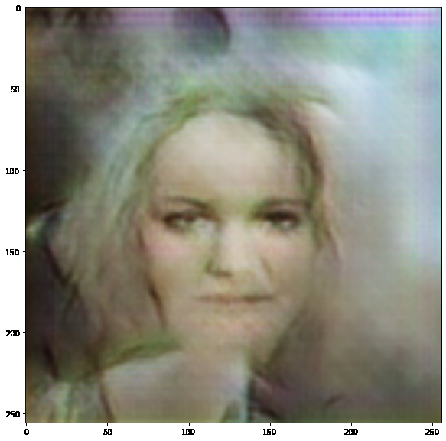
Summary
RUN 1 | RUN 2 | RUN 3 | RUN 4
Human images: 10‘000 Dog images: 4‘863 Cat images: 1‘668 | Human images: 4‘000 Dog images: 4‘000 Cat images: 1‘668 | Human images: 2‘000 Dog images: 2‘000 Cat images: 1‘668 | Human images: 23‘600 Dog images: 4‘800 Cat images: 1‘600
Image size: 128 * 128 px Number of images: 16‘533 Epochs: 200 Latent space: 128 dims Batch size: 64 Channels: 3 | Image size: 128 * 128 px Number of images: 9‘668 Epochs: 100 Latent space: 100 dims Batch size: 64 Channels: 3 | Image size: 128 * 128 px Number of images: 5‘668 Epochs: 100 Latent space: 128 dims Batch size: 64 Channels: 3 | Image size: 128 * 128 px Number of images: 30‘000 Epochs: 50 Latent space: 100 dims Batch size: 32 Channels: 3
Human | Dog | Human | Human
DATA
HYPER-PARAMETERS
RESULTS (HUMAN)

Slide 20
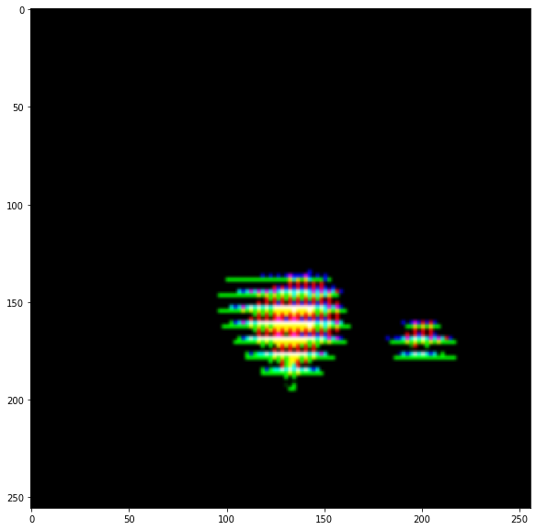
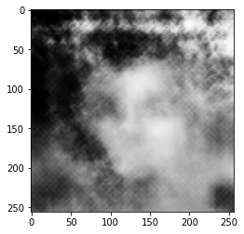
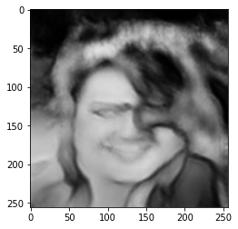
Summary
RUN 5 | RUN 6 | RUN 7 | RUN 8
Human images: 10‘000 Dog images: 9‘600 Cat images: 9‘600 | Human images: 20‘000 Dog images: 19‘200 Cat images: 19‘200 | Human images: 20‘000 Dog images: 19‘200 Cat images: 19‘200 | Human images: 10‘000 Dog images: 14‘400 Cat images: 14‘400 Eyeglasses images: 3‘397
Image size: 128 * 128 px Number of images: 29‘200 Epochs: 50 Latent space: 100 dims Batch size: 30 Channels: 3 | Image size: 128 * 128 px Number of images: 58‘400 Epochs: 50 Latent space: 100 dims Batch size: 30 Channels: 1 | Image size: 128 * 128 px Number of images: 58‘400 Epochs: 50 Latent space: 100 dims Batch size: 30 Channels: 1 | Image size: 128 * 128 px Number of images: 42‘197 Epochs: 50 Latent space: 100 dims Batch size: 30 Channels: 1
Human | Human | Human | Human
DATA
HYPER-PARAMETERS
RESULTS (HUMAN)
Image

Slide 21
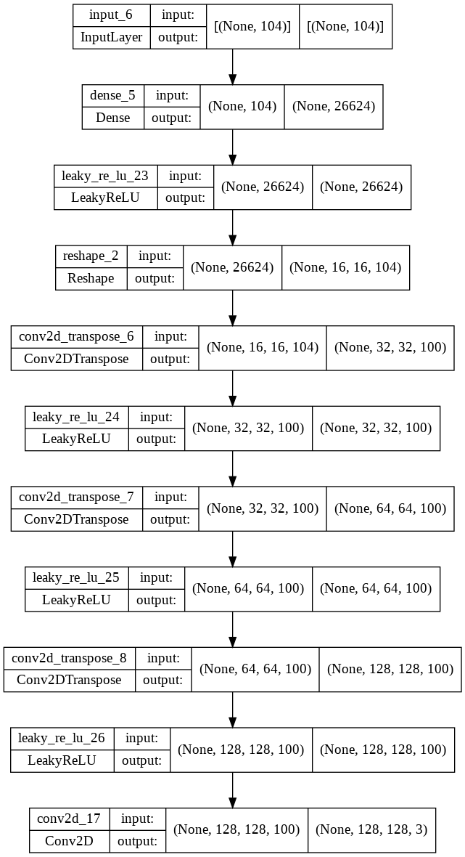
Final structure of the model
Let‘s have a look at the code in Google Colab
Generator
Discriminator

Slide 22
Evaluation
“
„
There is no objective function used when training GAN generator models, meaning models must be evaluated using the quality of the generated synthetic images.
Jason Brownlee (2019)
Manual GAN Evaluation
Most common approach: Save and compare models over time
Limitations and drawbacks:
Subjectivity
Required knowledge of the target domain
Only a limited number of images can be evaluated in a reasonable time

Slide 23
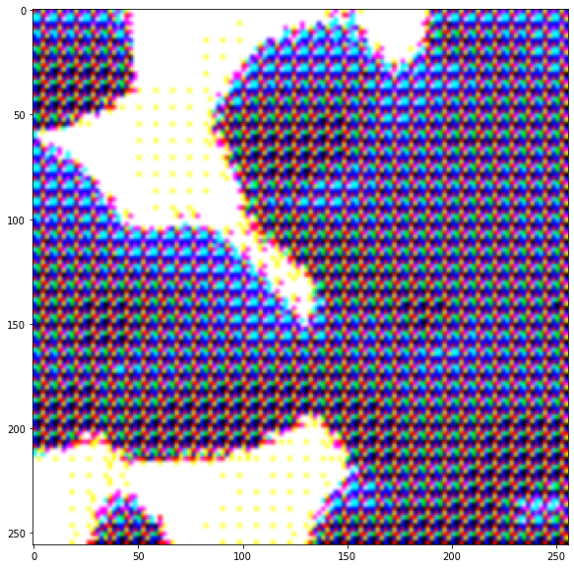
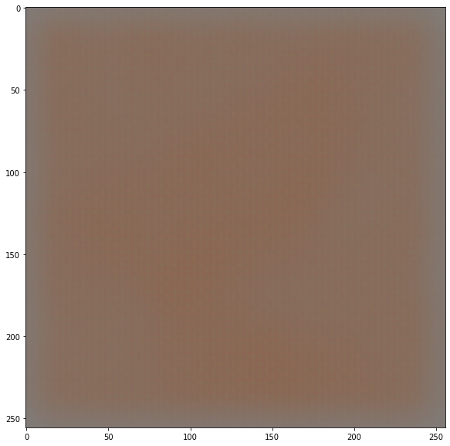
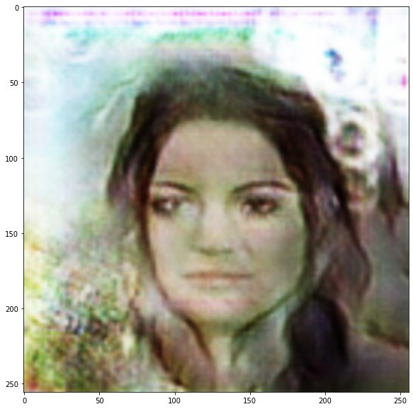
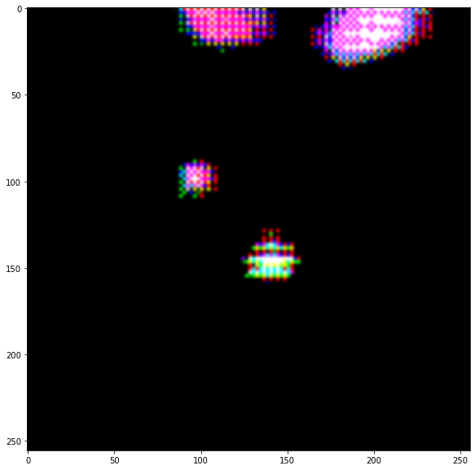
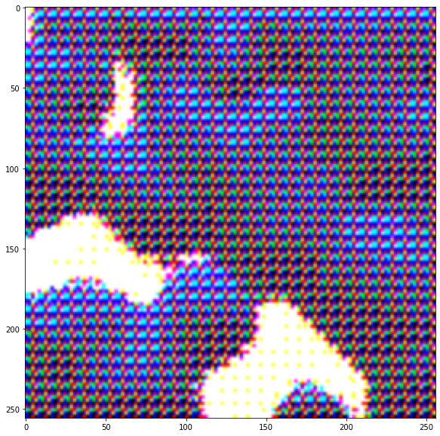
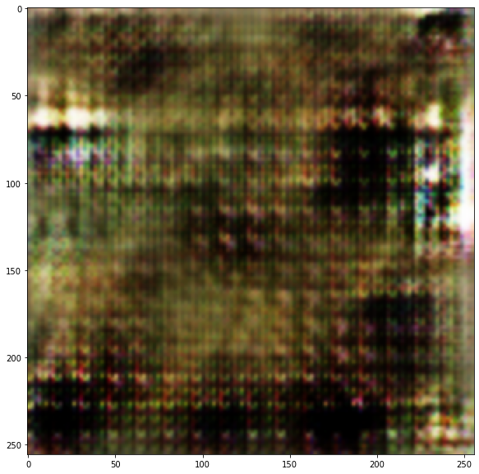
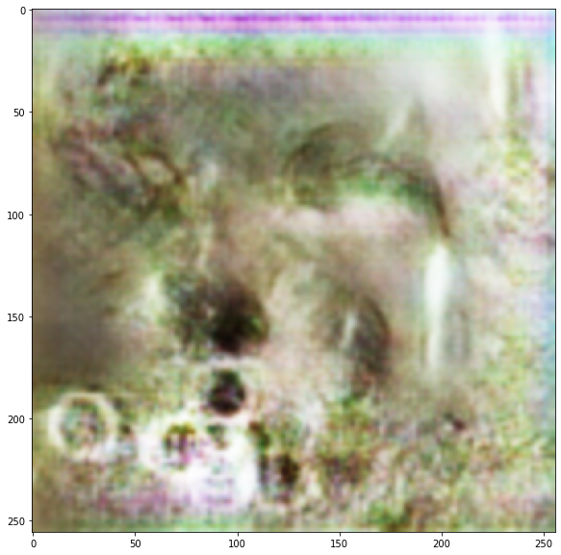
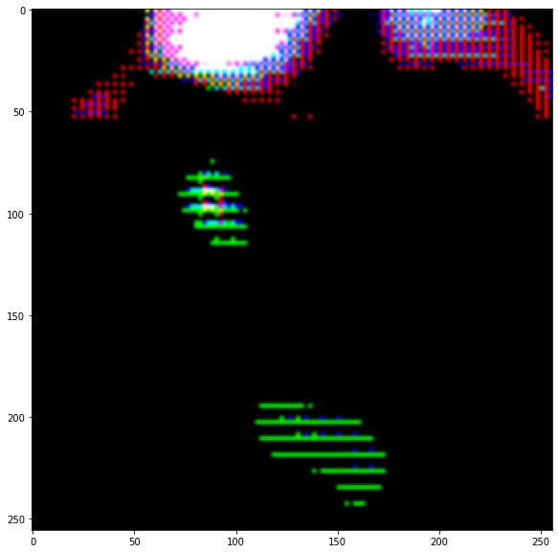
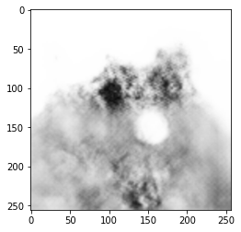
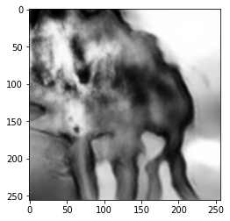
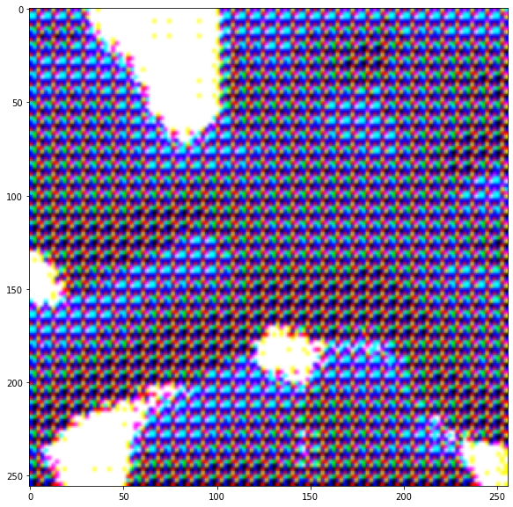
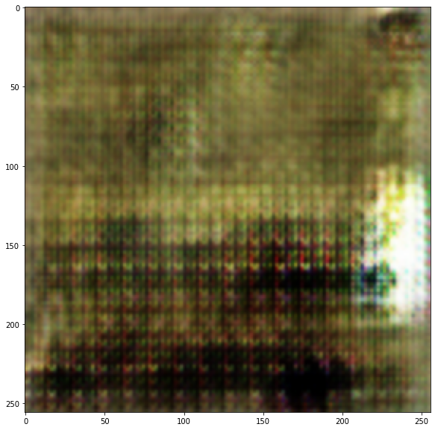
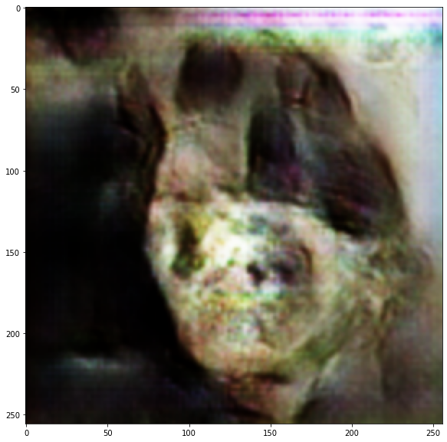
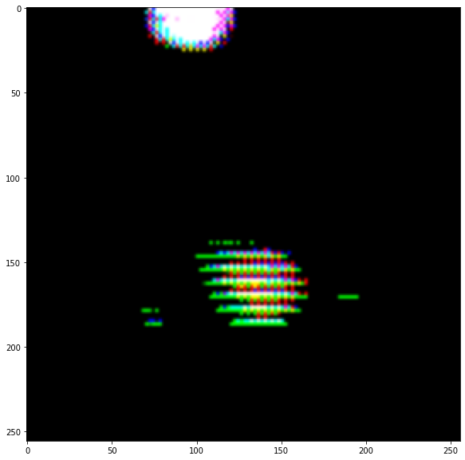
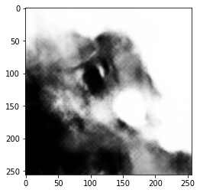
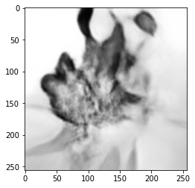
Evaluation
Comparison of models over time
Human images development:
Dog images development:
Cat images development:
Image
Image
Image

Slide 24
Evaluation
Conclusion
Great performance increases over the runs, with steps backwards sometimes
Performance of humans a lot better than the performance of dogs and cats
Eyeglasses not convincingly put on

Slide 25

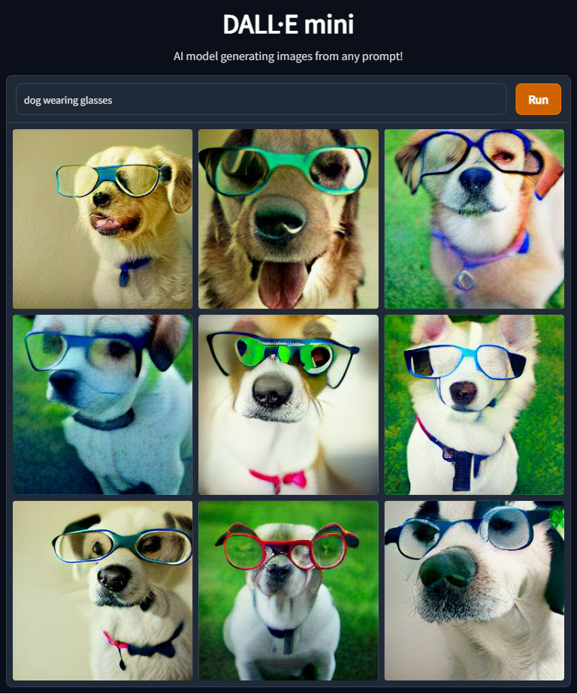
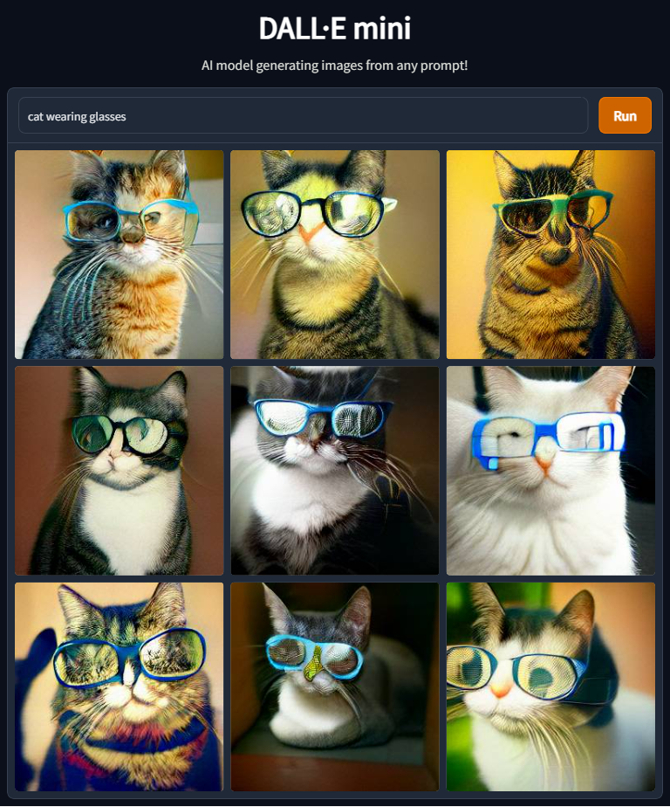
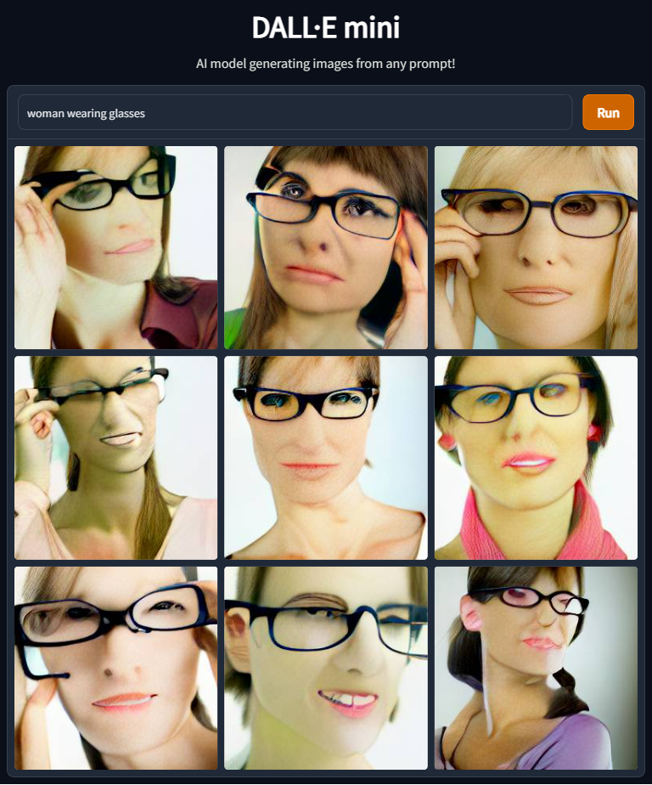
Comparison to existing models
State-of-the-art model as provided by the Dall-e mini from huggingface

Slide 26
Key learnings
Training process very time-intense (about 10h per run)
Training process very RAM-intense
When working with Google Colab, Pro-version with GPU required
Latent space: “The greater the better” does not apply here
Smaller batch size helps with training
Numpy-array as data input instead of importing the images directly and rescaling them
Image augmentation to make the data input bigger
Eyeglasses images might be still too few for the input
Future work: First create an object detection model and build the GAN based on that

Slide 27
Sources
Datasets
Liu, Z., Luo, P., Wang, X., Tang, X. (2021). Retrieved from: https://mmlab.ie.cuhk.edu.hk/projects/CelebA.html (27.06.2022).
Corrado, A. (2019). Retrieved from: https://www.kaggle.com/datasets/alessiocorrado99/animals10 (27.06.2022).
Code basis
Sayak, P. (2021). Conditional GAN. Retrieved from: https://keras.io/examples/generative/conditional_gan/ (27.06.2022).

Slide 28
Sources
Literature
Bhannot, K. (2018). Color Identification in Images. Retrieved from: https://towardsdatascience.com/color-identification-in-images-machine-learning-application-b26e770c4c71 (27.06.2022).
Brownlee, J. (2019a). How to Evaluate Generative Adversarial Networks. Retrieved from: https://machinelearningmastery.com/how-to-evaluate-generative-adversarial-networks/ (27.06.2022).
Brownlee, J. (2019b). How to Develop a GAN to Generate CIFAR10 Small Color Photographs. Retrieved from: https://machinelearningmastery.com/how-to-develop-a-generative-adversarial-network-for-a-cifar-10-small-object-photographs-from-scratch/ (27.06.2022).
Brownlee, J. (2019c). How to Develop a Conditional GAN (cGAN) From Scratch. Retrieved from: https://machinelearningmastery.com/how-to-develop-a-conditional-generative-adversarial-network-from-scratch/ (27.06.2022).
Brownlee, J. (2019d). How to Explore the GAN Latent Space When Generating Faces. Retrieved from: https://machinelearningmastery.com/how-to-interpolate-and-perform-vector-arithmetic-with-faces-using-a-generative-adversarial-network/ (27.06.2022).

Slide 29
Sources
Literature
Hui, J. (2018). GAN – Ways to improve GAN performance. Retrieved from: https://towardsdatascience.com/gan-ways-to-improve-gan-performance-acf37f9f59b (27.06.2022).
Inoue, S., Gonsalves, T. (2020). LCGAN: Conditional GAN with Multiple Discrete Classes. Retrieved from: https://www.jstage.jst.go.jp/article/pjsai/JSAI2020/0/JSAI2020_2K4ES202/_pdf/-char/ja (27.06.2022).
Sayak, P. (2021). Conditional GAN. Retrieved from: https://keras.io/examples/generative/conditional_gan/ (27.06.2022).
Shen, Y., Gu, J., Tang, X., Zhou, B. (2020). Interpreting the Latent Space of GANs for Semantic Face Editing. Retrieved from: https://openaccess.thecvf.com/content_CVPR_2020/papers/Shen_Interpreting_the_Latent_Space_of_GANs_for_Semantic_Face_Editing_CVPR_2020_paper.pdf (27.06.2022).
Yalcin, O.H. (2020). Image Generation in 10 Minutes with Generative Adversarial Networks. Retrieved from: https://towardsdatascience.com/image-generation-in-10-minutes-with-generative-adversarial-networks-c2afc56bfa3b (27.06.2022).

Slide 30
Sources
Images
Kamila Maciejewska (2019). Retrieved from: https://unsplash.com/photos/MVThvcFzVpA (27.06.2022).
Mollie Sivaram (2021a). Retrieved from: https://unsplash.com/photos/ts1zXzsD7xc (27.06.2022).
Mollie Sivaram (2021b). Retrieved from: https://unsplash.com/photos/lVAsH8fmnt8 (27.06.2022).

